Slide 1
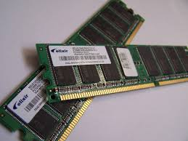
Memory

Slide 2
An Expanded View of the Memory System
Processor
Control
Memory
Memory
Memory
Datapath
Memory
Memory
Speed:
Fastest
Slowest
Size:
Smallest
Biggest
Cost:
Highest
Lowest

Slide 3
How can one get fast memory with less expense?
It is possible to build a computer which uses only static RAM (large capacity of fast memory)
  This would be a very fast computer
  But, this would be very costly
It also can be built using a small fast memory for present reads and writes.
  Add a Cache memory

Slide 4
Locality of Reference Principle
The Principle of Locality:
  Program access a relatively small portion of the address space at any instant of time.
Two Different Types of Locality:
  Temporal Locality (Locality in Time): If an item is referenced, it will tend to be referenced again soon.
  Spatial Locality (Locality in Space): If an item is referenced, items whose addresses are close by tend to be referenced soon.

Slide 5
Cache Memories
Cache memories are small, fast SRAM-based memories managed automatically in hardware.
  Hold frequently accessed blocks of main memory
CPU looks first for data in L1, then in L2, then in main memory.
Typical bus structure:
CPU chip
register file
ALU
L1
cache
cache bus
system bus
memory bus
main
memory
L2 cache
bus interface
I/O
bridge

Slide 6
How Does Cache Work?
Temporal Locality (Locality in Time): If an item is referenced, it will tend to be referenced again soon.
  Keep more recently accessed data items closer to the processor
Spatial Locality (Locality in Space): If an item is referenced, items whose addresses are close by tend to be referenced soon.
  Move blocks consists of contiguous words to the cache
Lower Level
Memory
To Processor
Upper Level
Cache
Block X
From Processor
Block Y
Notes:
Here is a simple overview of how cache works. Cache works on the principle of locality.
It takes advantage of the temporal locality by keeping the more recently addressed words in the cache.
In order to take advantage of spatial locality, on a cache miss, we will move an entire block of data that contains the missing word from the lower level into the cache.
This way, we are not ONLY storing the most recently touched data in the cache but also the data that are adjacent to them.

Slide 7

Cache Memory Organization
Cache - Small amount of fast memory
  Sits between normal main memory and CPU
  May be located on CPU chip or in system
  Objective is to make slower memory system look like fast memory.
There may be more levels of cache (L1, L2,..)

Slide 8
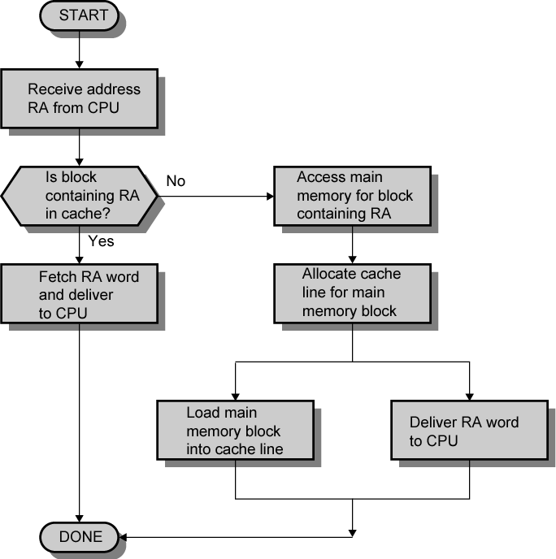
Cache Read Operation - Flowchart

Slide 9
Cache Design Parameters
Size of Cache
Size of Blocks in Cache
Mapping Function – how to assign blocks
Write Policy - Replacement Algorithm when blocks need to be replaced

Slide 10
Size Does Matter
Cost
  More cache is expensive
Speed
  More cache is faster (up to a point)
  Checking cache for data takes time

Slide 11

Typical Cache Organization

Slide 12
Cache Terminology
Hit - a cache access finds data resident in the cache memory
Miss - a cache access does not find data resident, forcing access to next layer down in memory hierarchy

Slide 13
Terminology
Miss ratio - percent of misses compared to all accesses = P_{miss}
  When performing analysis, always refer to miss ratio!
Hit access time - number of clocks to return a cache hit
Miss penalty - number of clocks to process a cache miss (typically, in addition to at least one clock of the hit time)

Slide 14
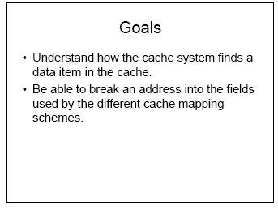

Slide 15
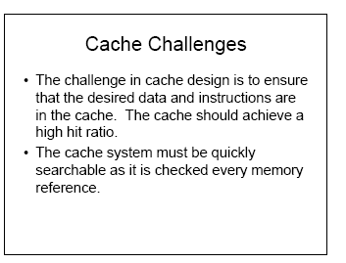

Slide 16
Lines & Tags
Cache is partitioned into lines (also called blocks). Each line has 4-64 bytes in it.
During data transfer, a whole line is read or written.
Each line has a tag that indicates the address of Main memory from where the line has been copied.

Slide 17
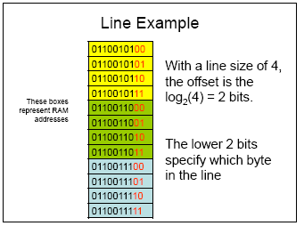

Slide 18
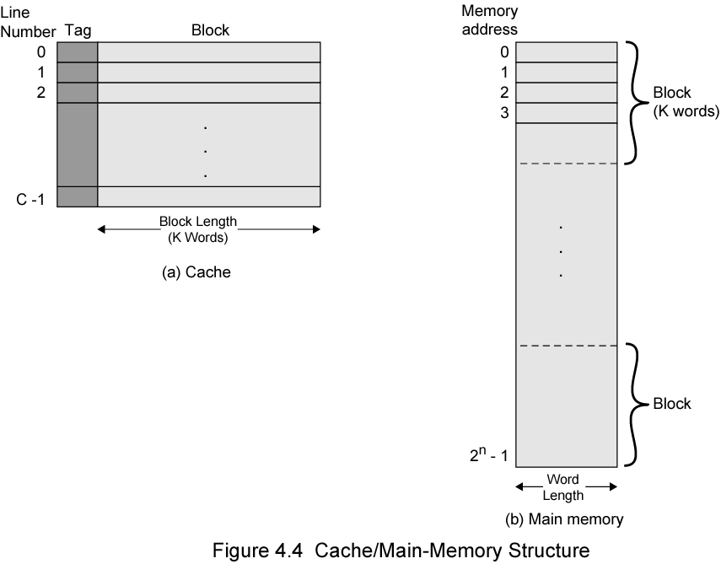
Cache/Main Direct Caching Memory Structure

Slide 19
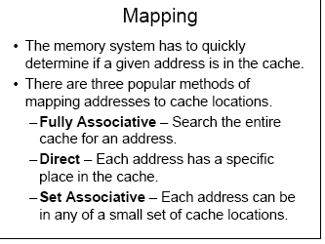

Slide 20
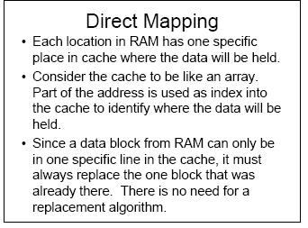

Slide 21
Example: Direct Mapping
Consider a direct mapped cache consisting of
  128 lines of 16 words each
  Total 2K words
Assume that the main memory is addressable by 16 bit address.
  Main memory is 64K having 4K blocks

Slide 22
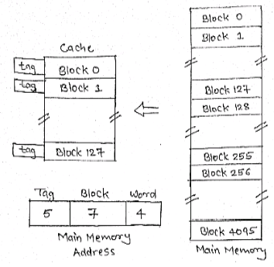
Example: Direct Mapping

Slide 23
Example: Direct Mapping
In Direct Mapping: block J of the main memory maps on to block J modulo 128 of the cache.
Thus main memory blocks 0,128,256,…. loaded into cache will stored at block 0; Block 1,129,257,….are stored at block 1 and so on…
Placement of a block in the cache is determined from memory address. Memory address is divided into 3 fields:
Tag
Line/Index
Offset/Word

Slide 24
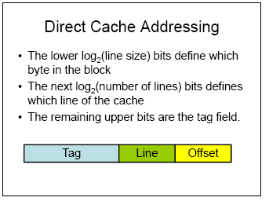

Slide 25
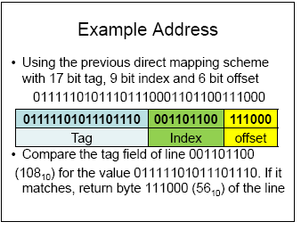

Slide 26
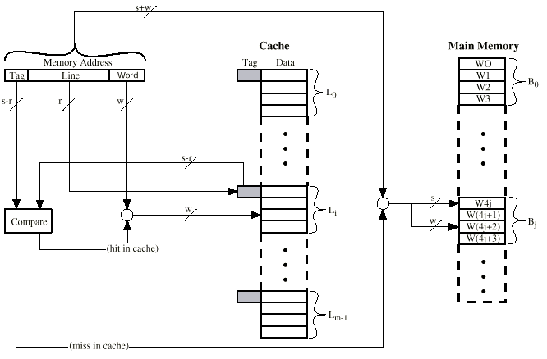
Direct Mapping Cache Organization

Slide 27
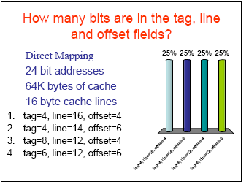

Slide 28
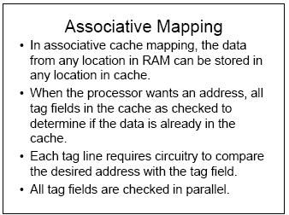

Slide 29
Example: Associative Mapping
Consider a cache consisting of
  128 lines(or blocks) of 16 words each
  Total 2K words
Assume that the main memory is addressable by 16 bit address.
  Main memory is 64K having 4K blocks

Slide 30
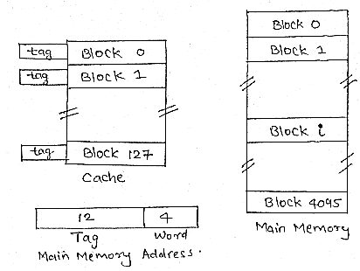
Example: Associative Mapping

Slide 31
Example: Associative Mapping
This is more flexible mapping method, main memory block can be placed into any cache block position.
The tag bits of an address received from the processor are compared to the tag bits of each block of the cache to see, if the desired block is present.
  Here, 12 tag bits are required to identify a memory block when it resides in the cache.
Cost of an associated mapped cache is higher than the cost of direct-mapped because of the need to search all 128 tag patterns to determine whether a block is in cache.
  This is known as associative search.

Slide 32
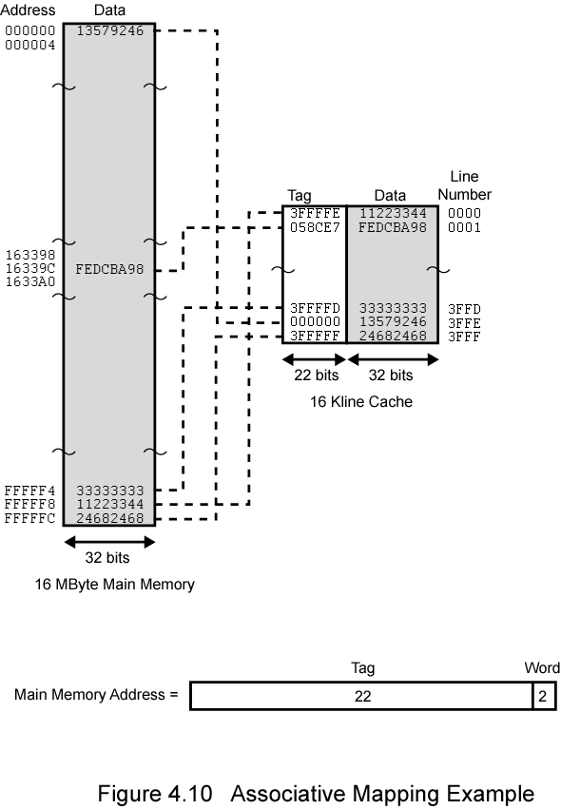
Associative Caching Example

Slide 33
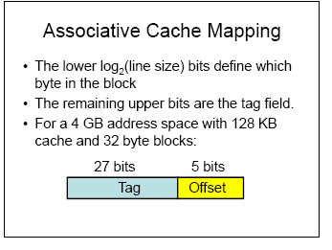

Slide 34
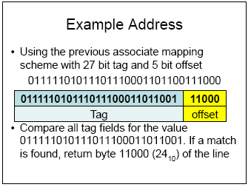

Slide 35

Fully Associative Cache Organization

Slide 36
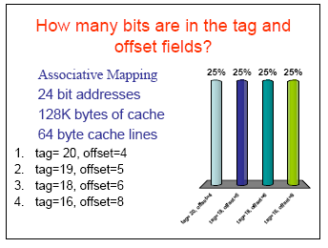

Slide 37
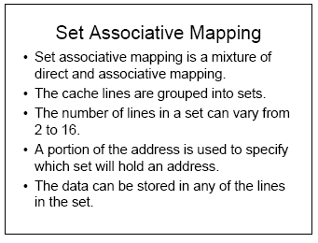

Slide 38
Example: Set Associative Mapping
Consider a cache with 2 lines per set
  128 lines of 16 words each
  Total 2K words
Assume that the main memory is addressable by 16 bit address.
  Main memory is 64K having 4K blocks

Slide 39
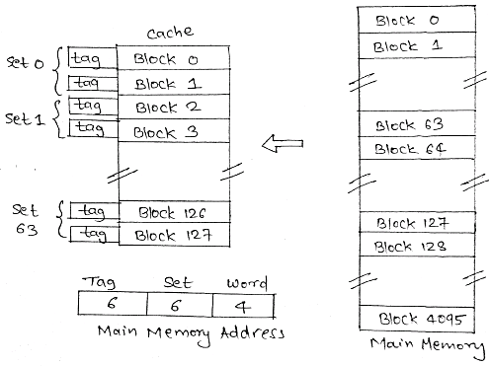
Example: Set Associative Mapping

Slide 40
Example: Set Associative Mapping
Cache blocks are grouped into sets and mapping allow block of main memory reside into any block of a specific set.
  Hence contention problem of direct mapping is eased , at the same time , hardware cost is reduced by decreasing the size of associative search.
In this example, memory block 0, 64, 128,…..,4032 map into cache set 0 and they can occupy any two block within this set.
  Having 64 sets means that the 6 bit set field of the address determines which set of the cache might contain the desired block.
  The tag bits of address must be associatively compared to the tags of the two blocks of the set to check if desired block is present. This is two way associative search.

Slide 41
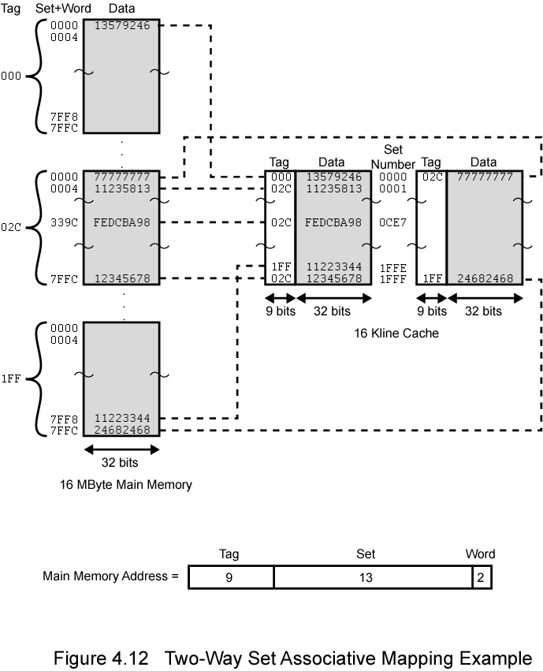
2 Way Set Assoc Example

Slide 42
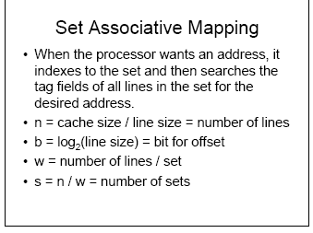

Slide 43
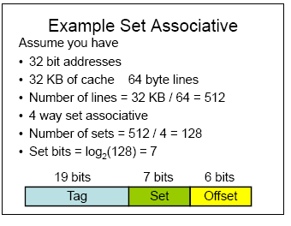

Slide 44
Example 2: SA
Consider a 32-bit computer that has an on-chip 16-Kbyte four-way set associative cache. Assume that the cache has a line size of four 32-bit words. Show how the different address fields are used with the cache. Determine where in the cache the word from memory location ABCDE8F8 is mapped?

Slide 45
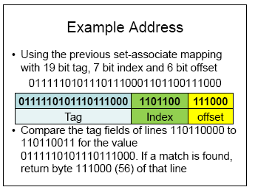

Slide 46
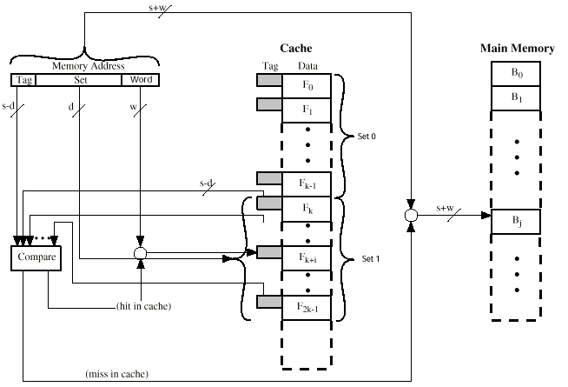
Two Way Set Associative Cache Organization

Slide 47
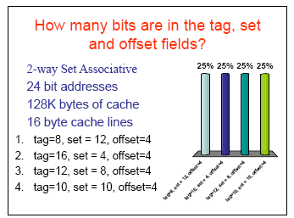

Slide 48
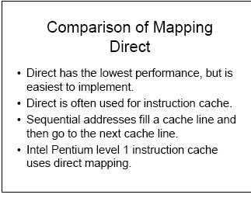

Slide 49
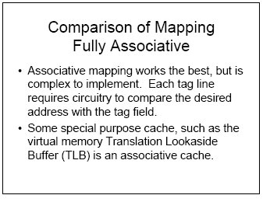

Slide 50
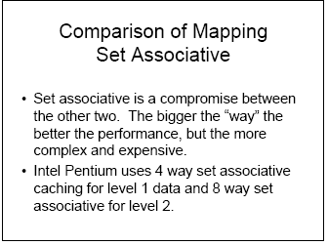

Slide 51
Types of Cache Misses
Compulsory Miss
It is also known as cold start misses or first references misses.
Occur when the first access to a block happens. Block must be brought into the cache.
Capacity Miss
Occur when the program working set is much larger than the cache capacity.
Since Cache can not contain all blocks needed for program execution, so cache discards these blocks.
Conflict Miss
Also known as collision misses or interference misses.
These misses occur when several blocks are mapped to the same set or block frame.
  These misses occur in the set associative or direct mapped block placement strategies.

Slide 52
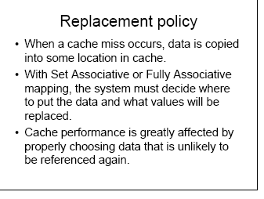

Slide 53
Replacement Algorithms (1)
Direct mapping
No choice
Each block only maps to one line
Replace that line

Slide 54
Replacement Algorithms (2)
Associative & Set Associative
Likely Hardware implemented algorithm (for speed)
First in first out (FIFO) ?
  replace block that has been in cache longest
Least frequently used (LFU) ?
  replace block which has had fewest hits
Least Recently used (LRU) ?
  Discards the least recently used items first
Random ?

Slide 55
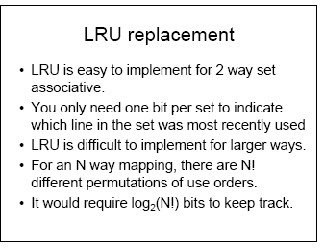

Slide 56
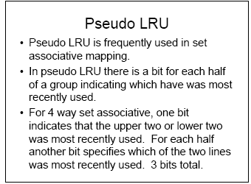

Slide 57
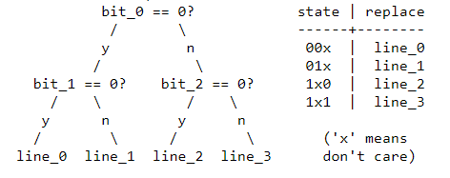
Pseudo LRU: 4-Way SA example
each bit represents one branch point in a binary decision tree
let 1 represent that the left side has been referenced more recently than the right side, and 0 vice-versa

Slide 58
Write Policy Challenges
Must not overwrite a cache block unless main memory is correct
Multiple CPUs/Processes may have the block cached
I/O may address main memory directly ?
(may not allow I/O buffers to be cached)

Slide 59
Write through
Data is simultaneously updated to cache and memory.
This process is simpler and more reliable. This is used when there are no frequent writes to the cache (Typically 15% or less of memory references are writes)
It Solves the inconsistency problem
Challenges:
A data write will experience latency (delay) as we have to write to two locations (both Memory and Cache)
Potentially slows down writes

Slide 60
Write back
Updates initially made in cache only and updated into the memory in later time
(Update bit for cache slot is set when update occurs)
If block is to be replaced, memory overwritten only if update bit is set
( 15% or less of memory references are writes )
I/O must access main memory through cache or update cache

Slide 61
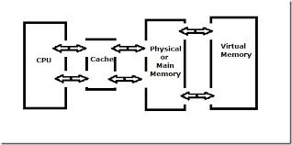
CASE STUDY: Virtual Memory

Slide 62
Virtual Memory
Cache memory enhances performance by providing faster memory access speed.
Virtual memory enhances performance by providing greater memory capacity, without the expense of adding main memory.
Instead, a portion of a disk drive serves as an extension of main memory.
If a system uses paging, virtual memory partitions main memory into individually managed page frames, that are written (or paged) to disk when they are not immediately needed.

Slide 63
6.5 Virtual Memory
Virtual Memory
A physical address is the actual memory address of physical memory.
Programs create virtual addresses that are mapped to physical addresses by the memory manager.
Page faults occur when a logical address requires that a page be brought in from disk.
Memory fragmentation occurs when the paging process results in the creation of small, unusable clusters of memory addresses.

Slide 64
6.5 Virtual Memory
Virtual Memory
Main memory and virtual memory are divided into equal sized pages.
The entire address space required by a process need not be in memory at once. Some parts can be on disk, while others are in main memory.
Further, the pages allocated to a process do not need to be stored contiguously-- either on disk or in memory.
In this way, only the needed pages are in memory at any time, the unnecessary pages are in slower disk storage.

Slide 65
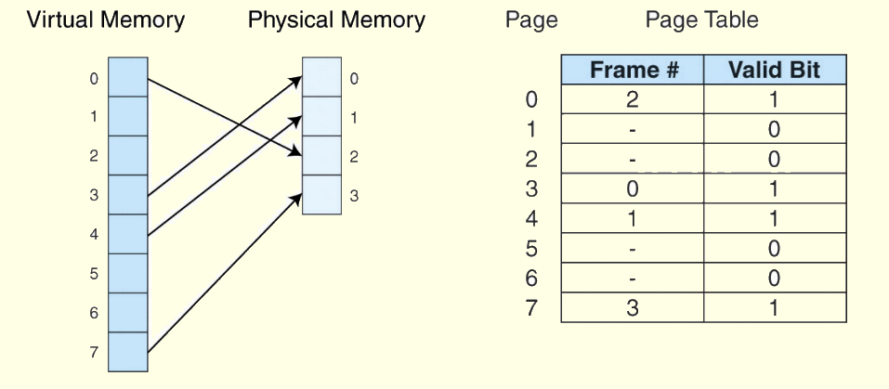
6.5 Virtual Memory
Virtual Memory
Information concerning the location of each page, whether on disk or in memory, is maintained in a data structure called a page table
There is one page table for each active process.

Slide 66
6.5 Virtual Memory
Virtual Memory
When a process generates a virtual address, the operating system translates it into a physical memory address.
To accomplish this, the virtual address is divided into two fields: A page field, and an offset field.
The page field determines the page location of the address, and the offset indicates the location of the address within the page
The logical page number is translated into a physical page frame through a lookup in the page table

Slide 67
6.5 Virtual Memory
Virtual Memory
If the valid bit is zero in the page table entry for the logical address, this means that the page is not in memory and must be fetched from disk.
  This is a page fault.
  If necessary, a page is evicted from memory and is replaced by the page retrieved from disk, and the valid bit is set to 1.
If the valid bit is 1, the virtual page number is replaced by the physical frame number.
The data is then accessed by adding the offset to the physical frame number.

Slide 68
6.5 Virtual Memory
Virtual Memory
As an example, suppose a system has a virtual address space of 8K and a physical address space of 4K, and the system uses byte addressing. Page size = 1024.
  # of virtual pages = ?
Virtual address ??
Physical memory address ??

Slide 69
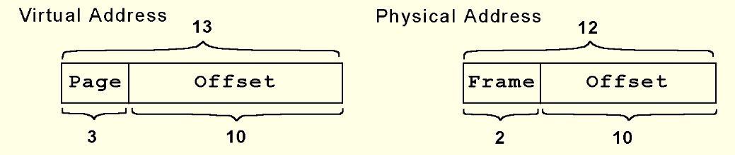
Virtual Memory

Slide 70
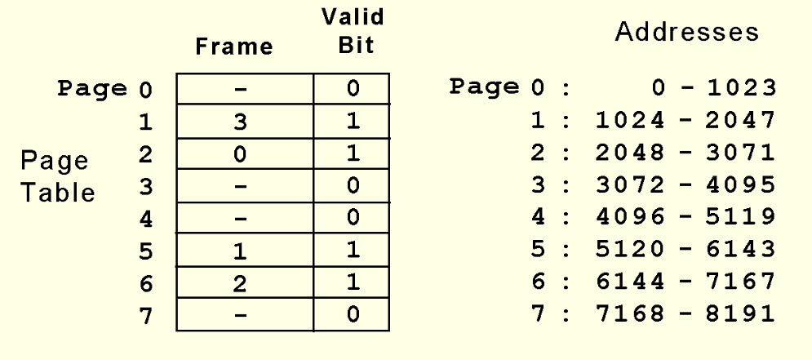
6.5 Virtual Memory
Virtual Memory
Suppose we have the page table shown below.
What happens when CPU generates address 5459₁₀ = 1010101010011₂?

Slide 71
6.5 Virtual Memory
Virtual Memory
The address 1010101010011₂ is converted to physical address 010101010011 because the page field 101 is replaced by frame number 01 through a lookup in the page table.

Slide 72
6.5 Virtual Memory
Virtual Memory
What happens when the CPU generates address 1000000000100₂?

Slide 73
6.5 Virtual Memory
Virtual Memory
We said earlier that effective access time (EAT) takes all levels of memory into consideration.
Thus, virtual memory is also a factor in the calculation, and we also have to consider page table access time.
Suppose a main memory access takes 200ns, the page fault rate is 1%, and it takes 10ms to load a page from disk. We have:
  EAT = 0.99(200ns + 200ns) 0.01(10ms) = 100, 396ns.

Slide 74
6.5 Virtual Memory
Virtual Memory
Even if we had no page faults, the EAT would be 400ns because memory is always read twice: First to access the page table, and second to load the page from memory
Because page tables are read constantly, it makes sense to keep them in a special cache called a translation look-aside buffer (TLB)
TLBs are a special associative cache that stores the mapping of virtual pages to physical pages

Slide 75
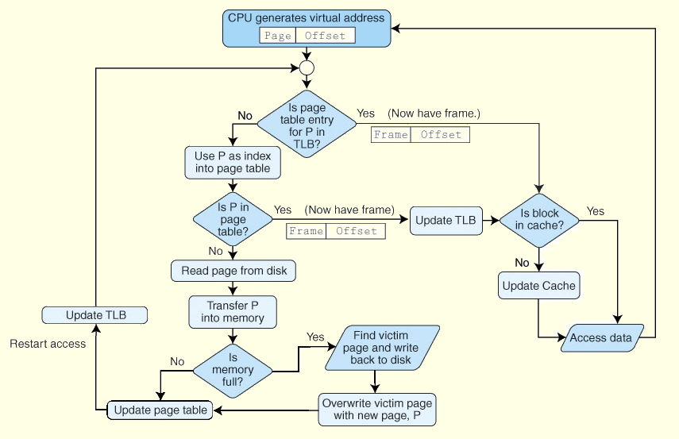
6.5 Virtual Memory
Virtual Memory

Slide 76
6.5 Virtual Memory
Virtual Memory
Another approach to virtual memory is the use of segmentation
Instead of dividing memory into equal-sized pages, virtual address space is divided into variable-length segments, often under the control of the programmer
A segment is located through its entry in a segment table, which contains the segment’s memory location and a bounds limit that indicates its size
After a page fault, the operating system searches for a location in memory large enough to hold the segment that is retrieved from disk.

Slide 77
6.5 Virtual Memory
Virtual Memory
Both paging and segmentation can cause fragmentation
Paging is subject to internal fragmentation because a process may not need the entire range of addresses contained within the page. Thus, there may be many pages containing unused fragments of memory
Segmentation is subject to external fragmentation, which occurs when contiguous chunks of memory become broken up as segments are allocated and deallocated over time.

Slide 78
6.5 Virtual Memory
Virtual Memory
Large page tables are cumbersome and slow, but with its uniform memory mapping, page operations are fast. Segmentation allows fast access to the segment table, but segment loading is labor-intensive.
Paging and segmentation can be combined to take advantage of the best features of both by assigning fixed-size pages within variable-sized segments.
Each segment has a page table. This means that a memory address will have three fields, one for the segment, another for the page, and a third for the offset.

Slide 79
6.6 A Real-World Example
Virtual Memory
The Pentium architecture supports both paging and segmentation, and they can be used in various combinations including unpaged unsegmented, segmented unpaged, and unsegmented paged.
The processor supports two levels of cache (L1 and L2), both having a block size of 32 bytes.
The L1 cache is next to the processor, and the L2 cache sits between the processor and memory.
The L1 cache is in two parts: and instruction cache (I-cache) and a data cache (D-cache).

Slide 80
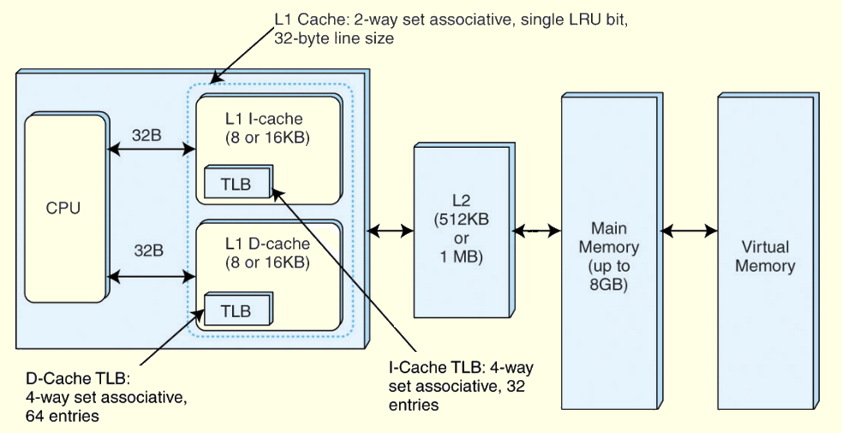
6.6 A Real-World Example
Virtual Memory

Slide 81
Coherency with Multiple Caches
Bus Watching with write through
1) mark a block as invalid when another
cache writes back that block, or
2) update cache block in parallel with
memory write
Hardware transparency
(all caches are updated simultaneously)
I/O must access main memory through cache or update cache(s)
Multiple Processors & I/O only access non-cacheable memory blocks

Slide 82
Choosing Line (block) size
8 to 64 bytes is typically an optimal block
(obviously depends upon the program)
Larger blocks decrease number of blocks in a given cache size, while including words that are more or less likely to be accessed soon.
Alternative is to sometimes replace lines with adjacent blocks when a line is loaded into cache.
Alternative could be to have program loader decide the cache strategy for a particular program.

Slide 83
Multi-level Cache Systems
As logic density increases, it has become advantages and practical to create multi-level caches:
1) on chip
2) off chip
L2 cache may not use system bus to make caching faster
If L2 can potentially be moved into the chip, even if it doesn’t use the system bus
Contemporary designs are now incorporating an on chip(s) L3 cache . . . .

Slide 84
Split Cache Systems
Split cache into:
1) Data cache
2) Program cache
Advantage:
Likely increased hit rates
- data and program accesses display different behavior
Disadvantage:
Complexity

Slide 85
References
M. Morris Mano, Computer System Architecture, Prentice Hall of India Pvt Ltd, 3rd Edition (upda ted) , 30 June 2017.
William Stallings, Computer Organization and Architecture–Designing for Performance, Ninth Edition, Pearson Education, 2013.

